Slide 1
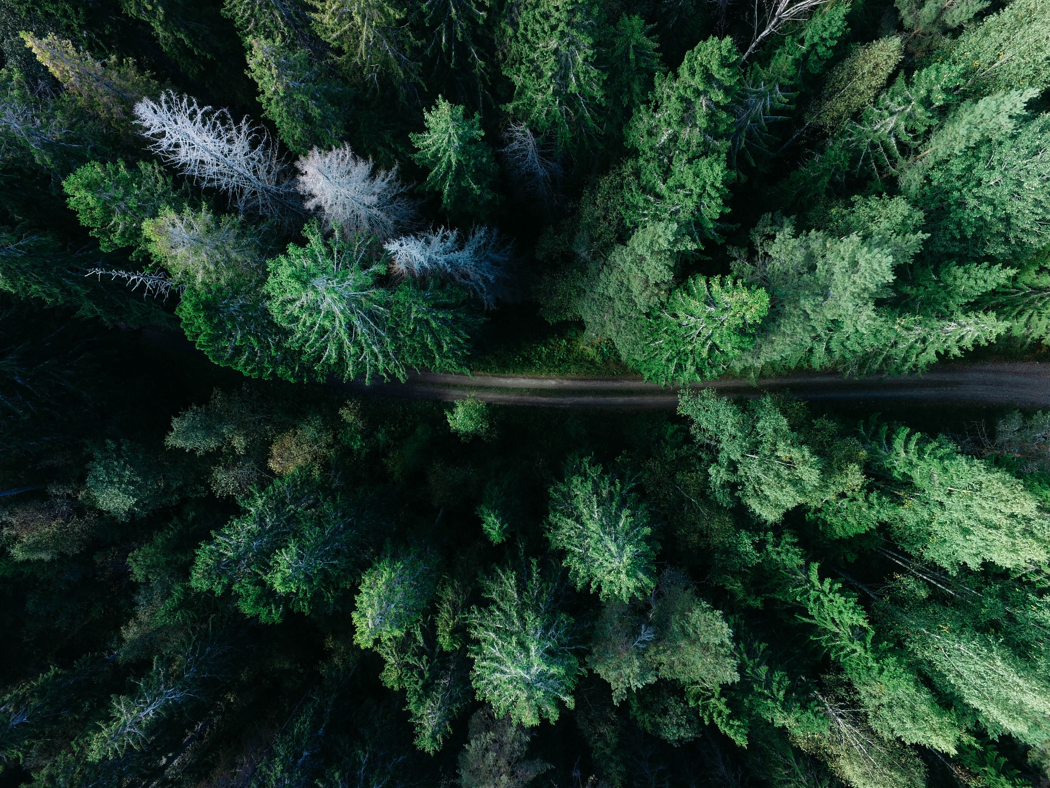


GREEN ARCHITECTURE

Slide 2
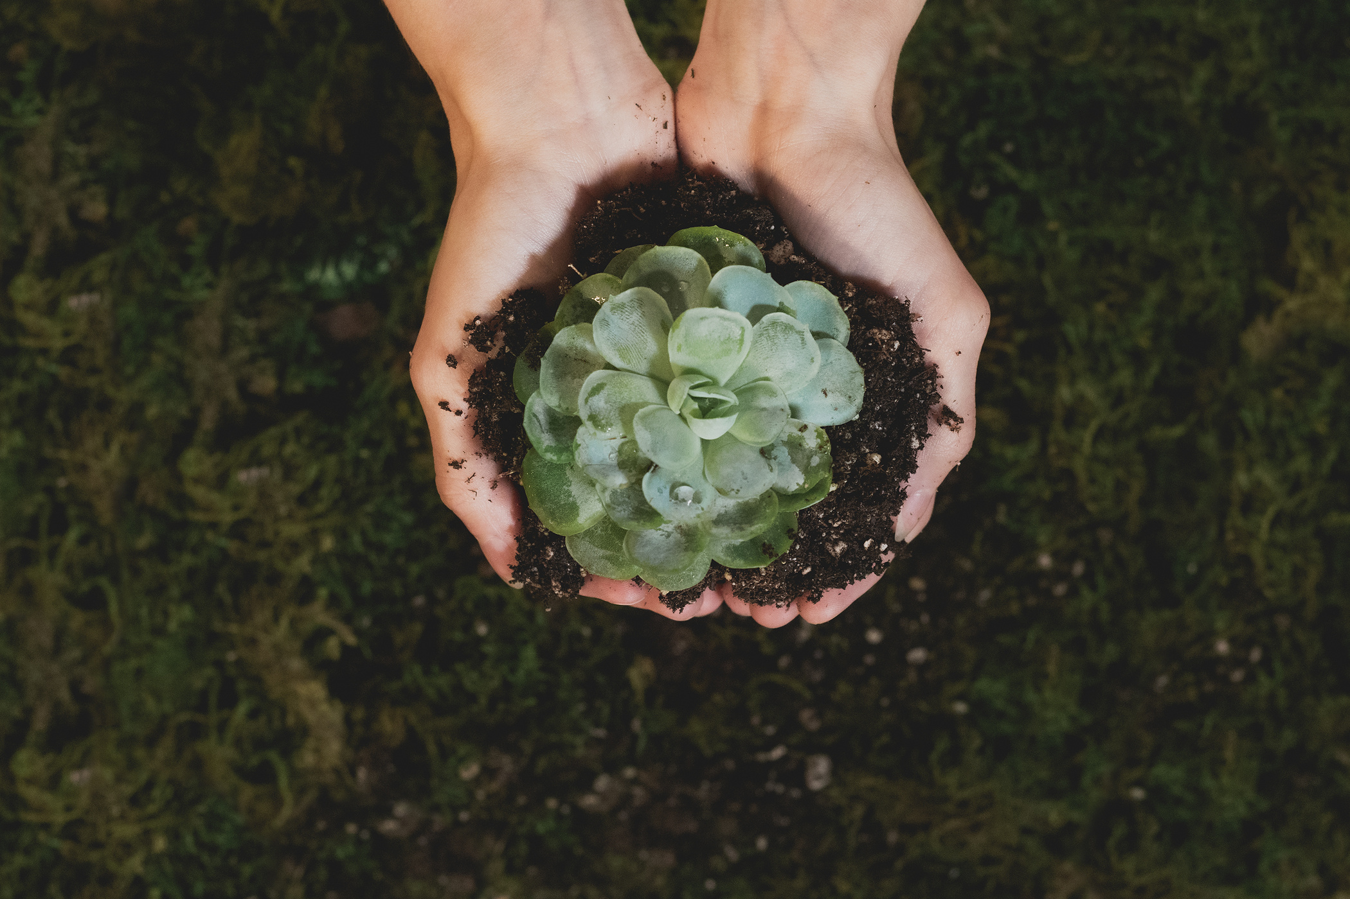
PROJECT EXPO
THEME-GREEN ARCHITECTURE
HEMALI CHOTALIA. REG.NO-23BHI10073
(TEAM LEADER)
ADITYA SINGHAL. REG.NO-23BHI10065
NAMAN DHAKAD REG.NO-23BCE11359

Slide 3

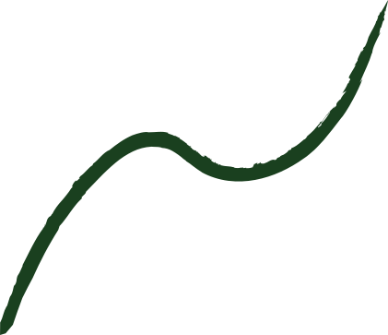

Contents
PROBLEM STATEMENT
WORKING PRINCIPLE
REFERENCE
RESULT/
CONCLUSION
J
NOVELTY

Slide 4

PROBLEM STATEMENT
USE OF GIS(GEOGRAPHIC INFORMATION SYSTEMS) TO CALCULATE THE WATER FOOTPRINT.
OBJECTIVE:-
The main objective of this project is to leverage Geographic Information Systems (GIS) technology to quantify the water used in producing various everyday items. GIS is a computer system designed for capturing, storing, checking, and displaying data related to positions on Earth's surface. This technology aids in understanding water consumption patterns and promoting sustainable water management practices.

Slide 5
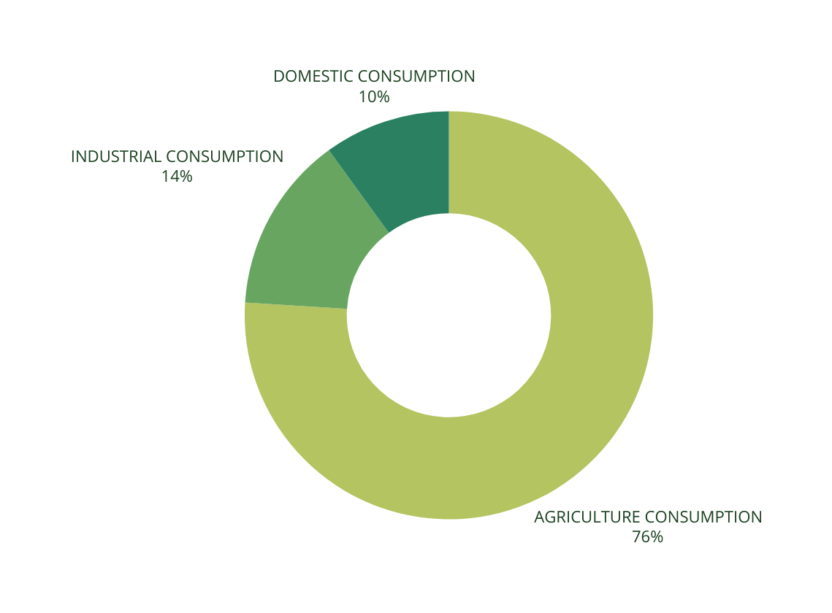
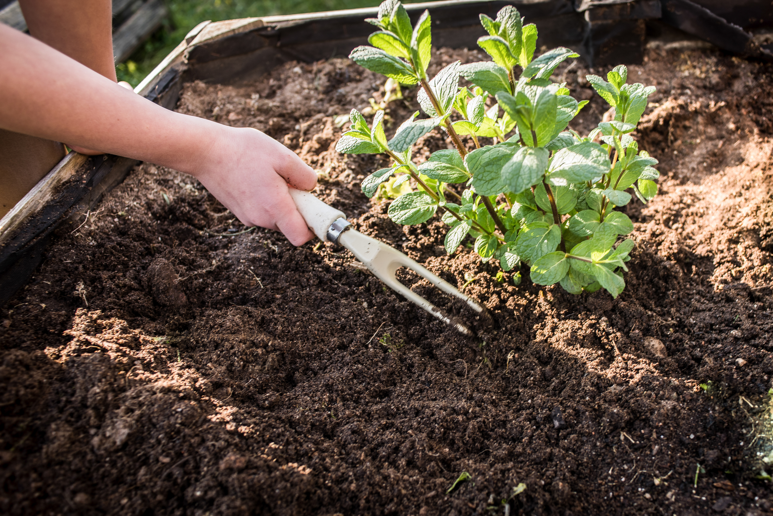
OBJECTIVE:
Gathering Data for Water Usage
2.Analyzing Data
3.Calculating Water Footprint

Slide 6
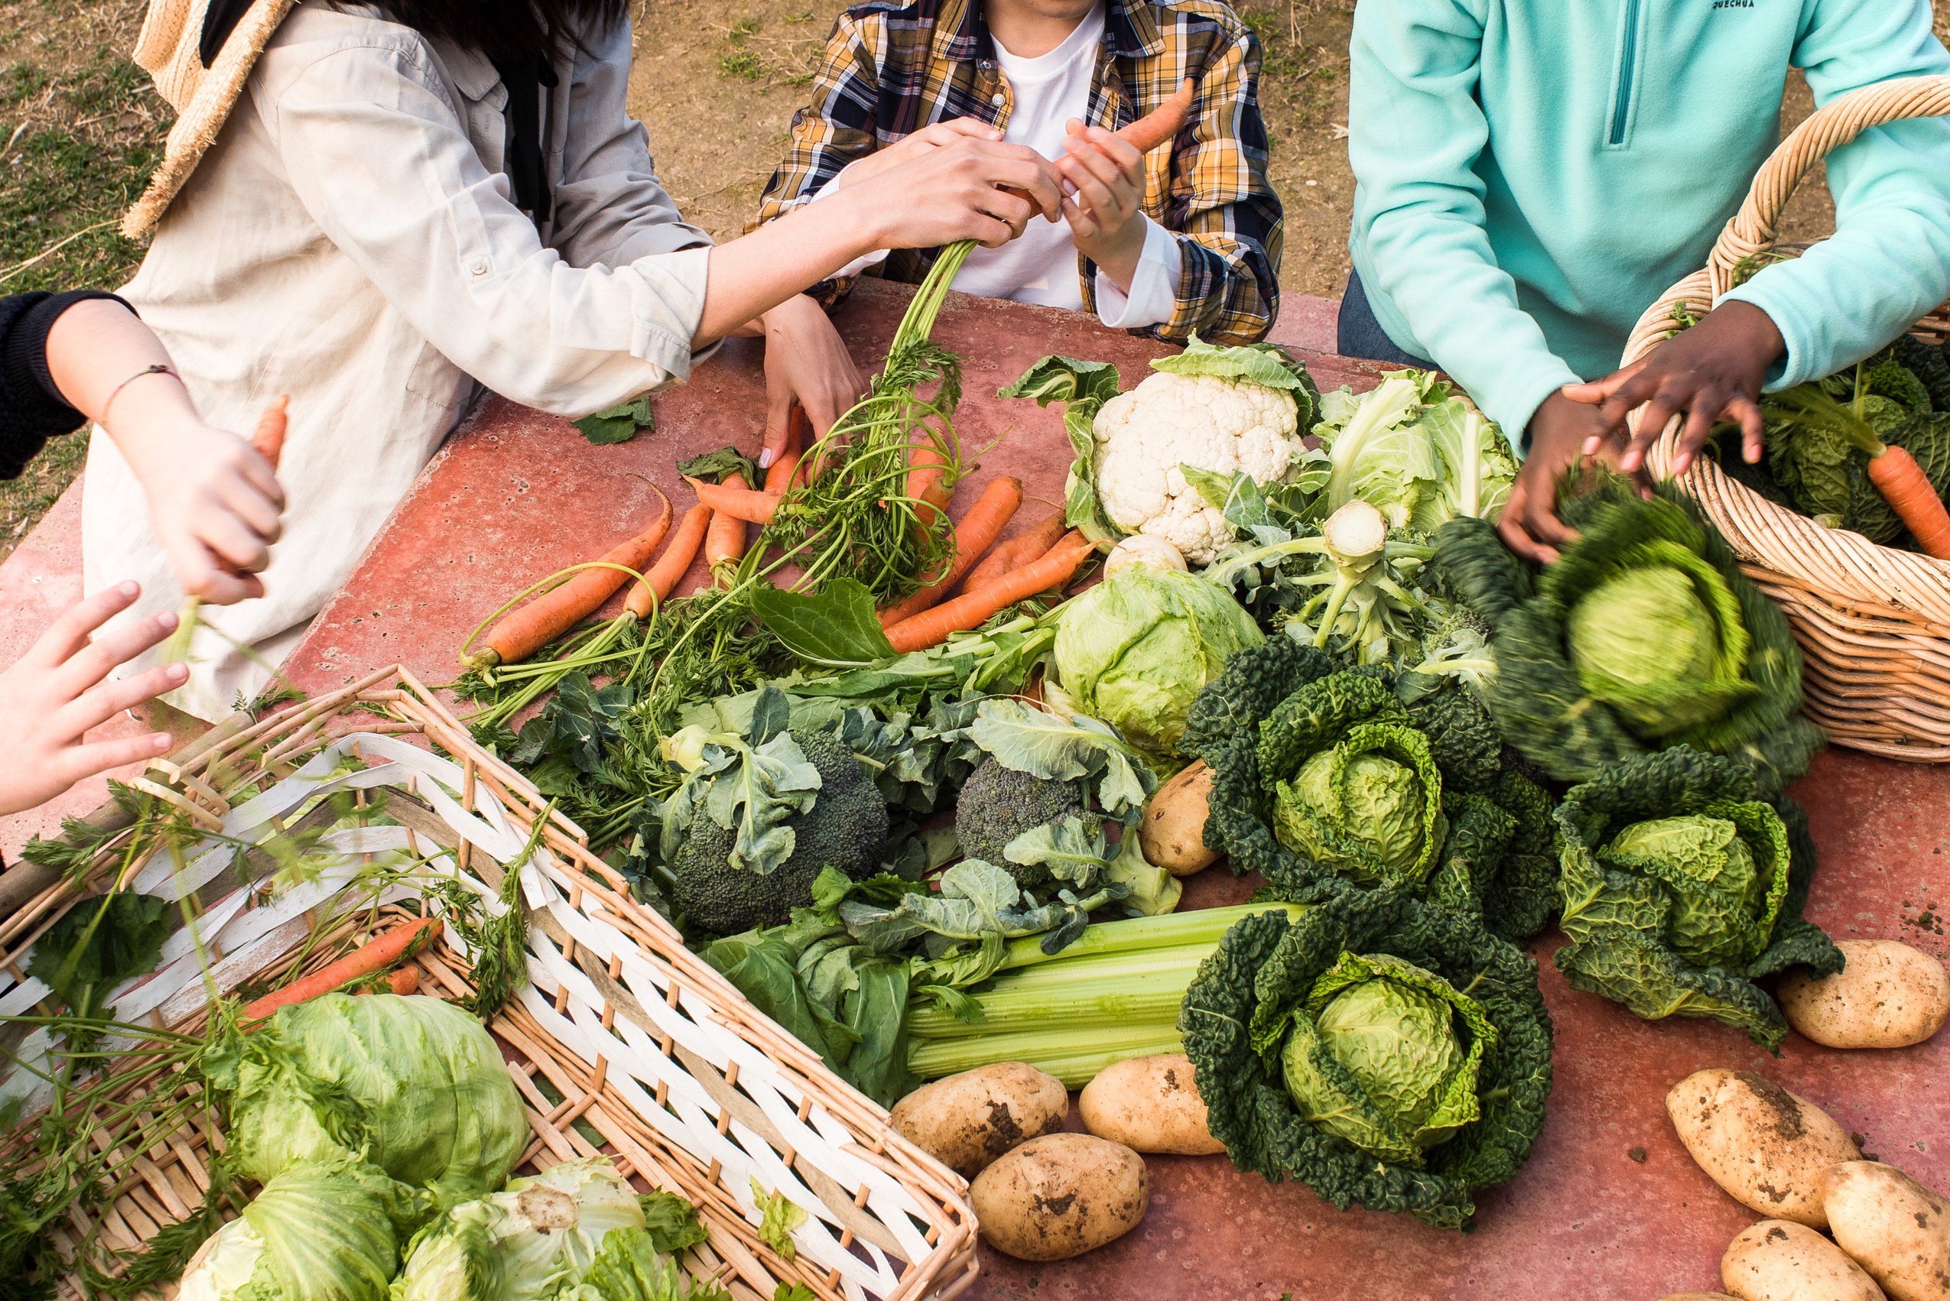
NOVELTY
What makes GIS so unique and different from others is that –
1)GIS helps us to identify areas with high water usage,By identifying this areas we can develop sustainable approach to efficienty use of water and prevent water scarcity.So indirectly it helps with resourses management.
2)GIS allows deeper visualistion. With GIS, we can create maps that visually display water usage. This makes it easier to see which areas use the most water and why.
3)GIS helps us to integrate water footprints with factors affecting them.We combine water usage data with information like climate, soil type, and land use and get deeper analysis.

Slide 7
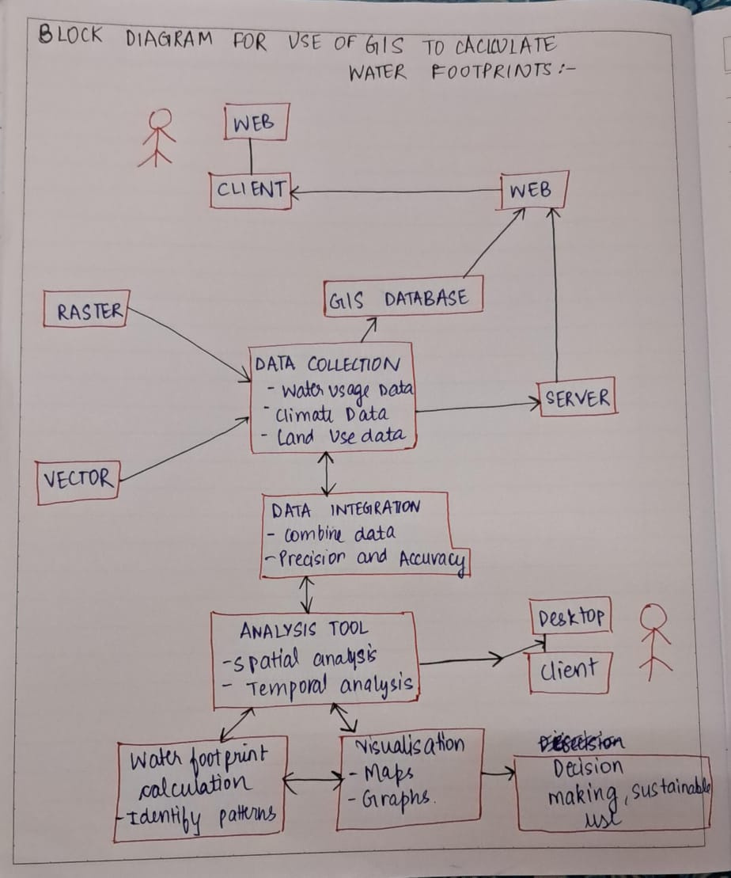
BLOCK DIAGRAM:
Data Collection
Data Integration
Data Analysis
Water Footprint Calculation
Identify High-Usage Areas
Strategy Development
Implementation and Monitoring
Reporting and Continuous Improvement

Slide 8
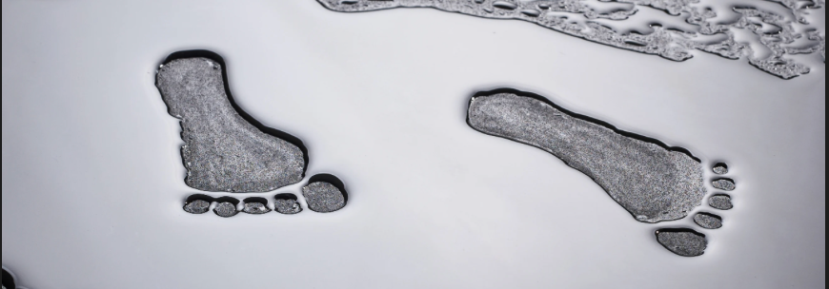
WORKING PRINCIPLE
The goal of this project is to use GIS technology to measure and analyze the water footprint associated with the production of everyday items. Here's how it works:
1.Data Collection:
Sources: We gather data from various sources such as maps, satellites, and sensors.
Details: This data provides detailed information about water usage across different regions and over time.

Slide 9
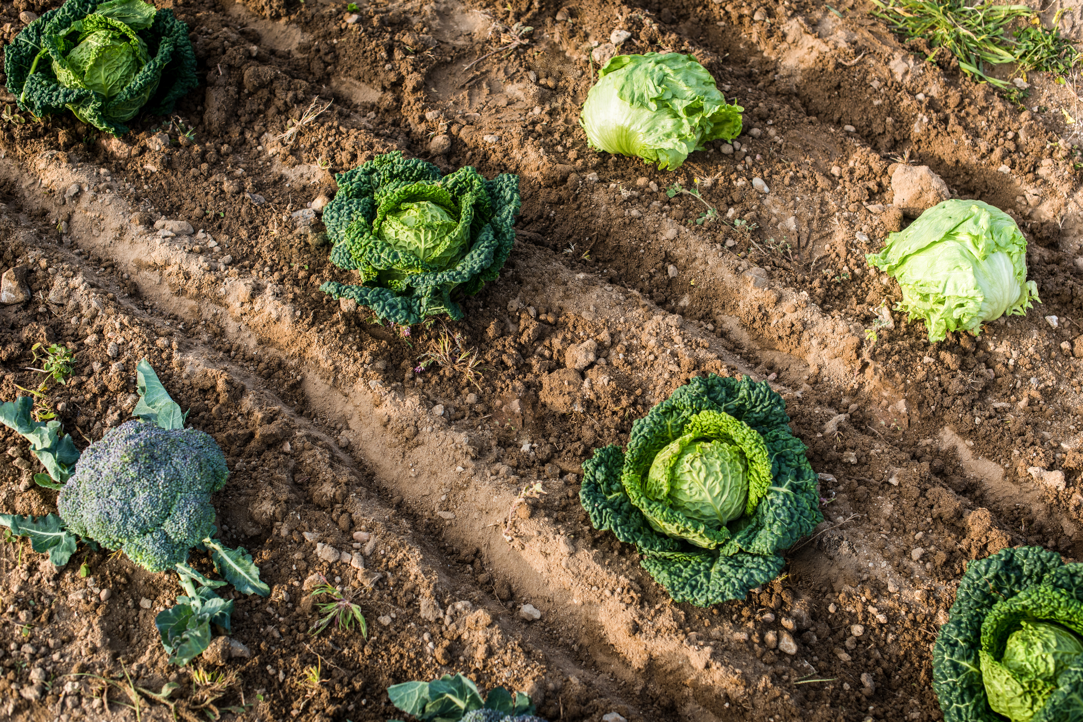
2.Data Analysis:
GIS Tools: Using GIS tools, we analyze the collected data to identify patterns and trends in water consumption.
Geographic Insights: This analysis helps us understand how water usage varies across different geographic areas and during different time periods.
3.Water Footprint Calculation:
Direct Water Usage: We calculate the amount of water directly used in the production processes of various items.
Indirect Water Usage: We also account for the water used to produce the raw materials and other goods needed for these items.
4.Identifying High-Usage Areas:
By pinpointing areas with high water usage, we can focus our efforts on developing strategies to reduce water consumption in these regions.

Slide 10
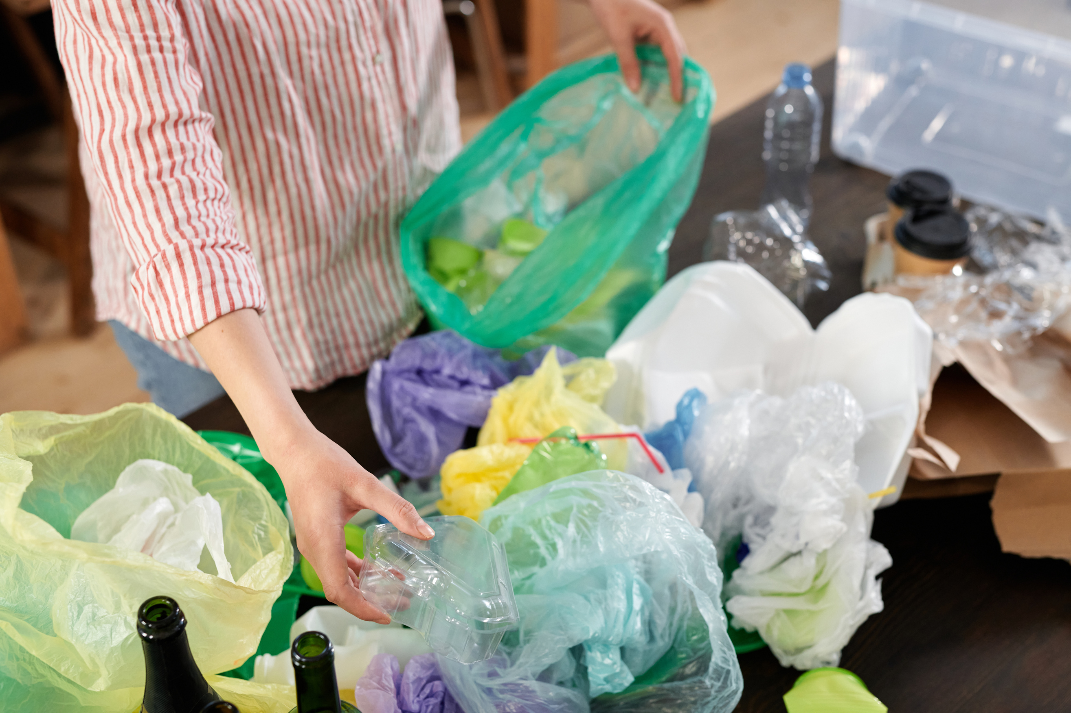
RESULT/
CONCLUSION
1.Comprehensive Water Usage Data:
Successfully gathered detailed water usage data from various sources such as maps, satellites, and sensors.
2.Accurate Water Footprint Calculations:
Determined the direct and indirect water usage involved in the production of everyday items.
3.Actionable Insights:
The analysis provided clear insights into regions and processes where water usage could be reduced.

Slide 11
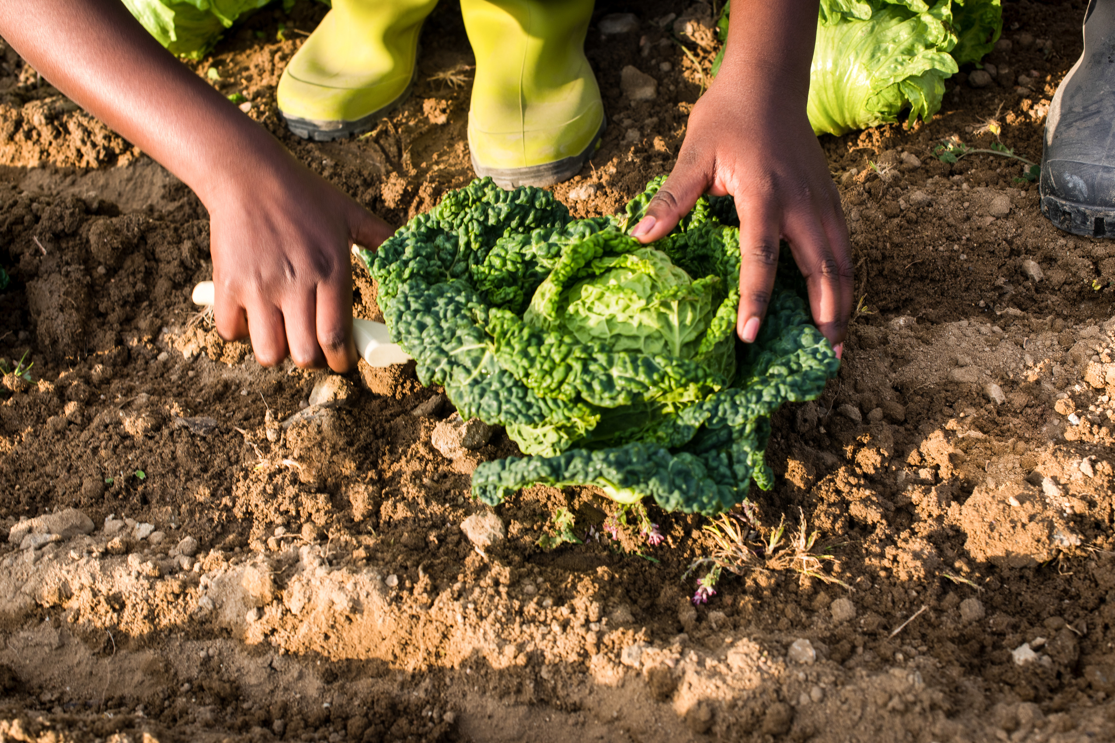
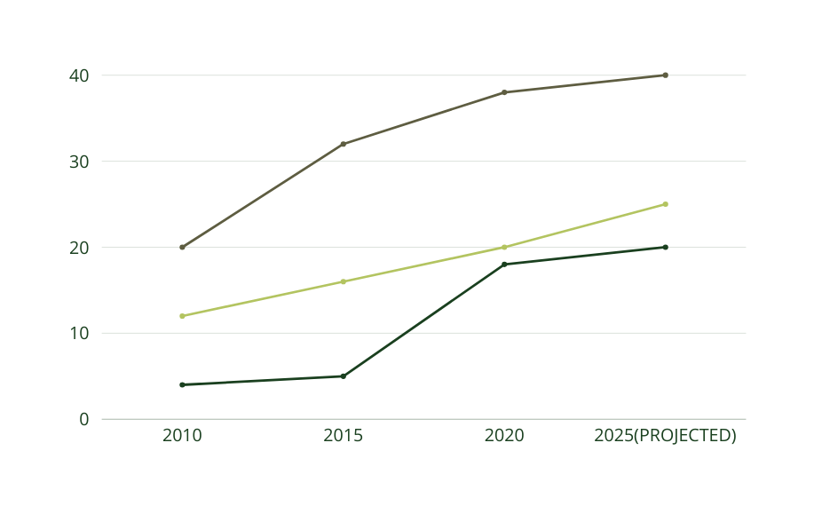
FUTURE SCOPE
4.Scalability:
Scale the project to cover more geographic regions and a wider variety of products.
5.Policy and Education:
Use the insights from this project to inform policy-making and guide regulations on water usage.
1.Expanded Data Collection:
Incorporate more diverse data sources and enhance the accuracy and detail of water usage data.
2.Integration with Other Environmental Data:
Combine water usage data with other environmental data, such as carbon footprint and energy consumption, to provide a holistic view of resource use and sustainability.
3.Advanced Analysis Techniques:
Implement advanced GIS and data analytics techniques, including machine learning, to uncover deeper insights and predict future water usage trends.

Slide 12
REFERENCES-
Integrating High Resolution Water Footprint and GIS for Promoting Water Efficiency in the Agricultural Sector: A Case Study of Plantation Crops in the Jordan Valley
LINK--
https://www.frontiersin.org/journals/plant-science/articles/10.3389/fpls.2016.01877/full
Geographic Information Systems in Water Distribution Networks
LINK--Https://www.researchgate.net/publication/235953481_Geographic_Information_Systems_in_Water_Distribution_Networks
The Use of GIS in Water Resource
LINK-
https://uizentrum.de/the-use-of-gis-in-water-resource/?lang=en
YOUTUBE VIDEO
LINK--
https://www.youtube.com/live/RPIMcqfs488?si=nMo6XodAgcaDQGxk

Slide 13
VIT BHOPAL UNIVERSITY
HEMALI CHOTALIA (TEAM LEADER) 23BHI10073
(Hemali.23bhi10073@vitbhopal.ac.in)
ADITYA SINGHAL 23BHI10065
(Aditya.23bhi10065@vitbhopal.ac.in)
NAMAN DHAKAD 23BCE11359
(Naman.23bce11359@vitbhopal.ac.in)
THANK YOU

